Slide 1
Fundamentals of LiDAR
Anjana Venkatesh 862392044
Harish Kulasekaran, 862392396
Piyush Dashpute, 862393195

Slide 2

Introduction to LiDAR
LiDAR - Light Detection and Ranging
Remote sensing method that uses light in the form of a pulsed laser to measure distances
Notes:
LiDAR – Light Detection and Ranging.
This technology, similar to radar but using light instead of radio waves, is transforming how we capture detailed 3D models of the Earth's surface.
Its applications range from environmental studies to urban planning and even in the development of autonomous vehicles.
Let's explore how this incredible technology works and its wide applications.

Slide 3

Fundamentals of LiDAR
What is LiDAR?
Emits laser lights to sample the earth’s surface and producing accurate 3D measurements
Key Components:
Collection vehicle
Laser scanner
GPS
INS information

Slide 4
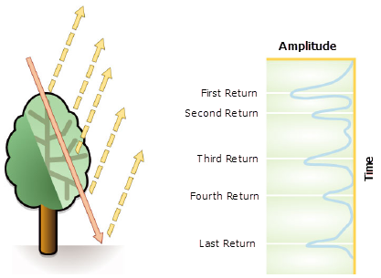
LiDAR Data Attributes
Data Attributes:
Intensity
Number of returns
RGB
Point Classification

Slide 5

Types of LiDAR
Airborne
Topographic lidar
Derive surface models
Bathymetric lidar
Water penetrating

Slide 6
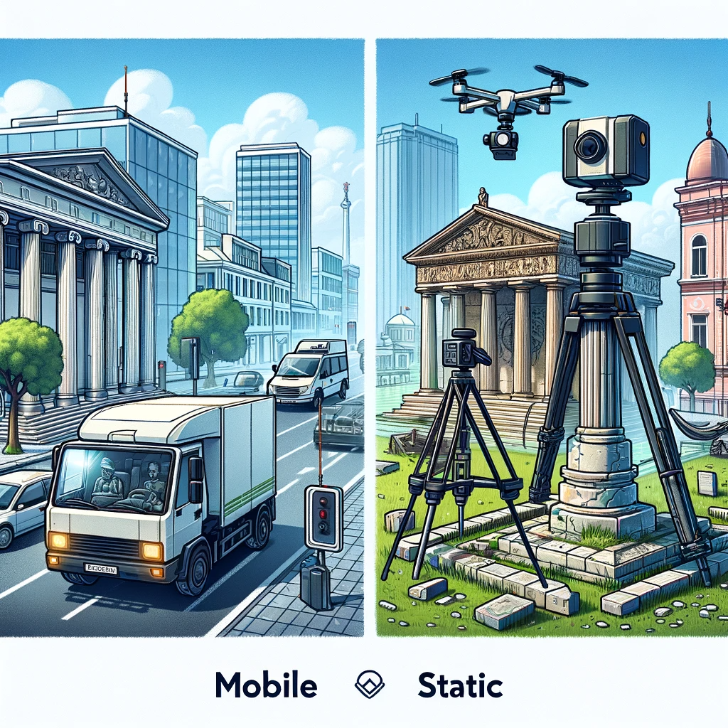
Terrestrial LiDAR
2. Terrestrial lidar
Mobile
Mounted on a moving vehicle
Static
Mounted on a tripod

Slide 7

LiDAR in Practice

Slide 8
Storing LiDAR
LiDAR Data Attributes
X, Y, Z, Intensity & Classification
(X,Y) -> Location
Z -> Elevation
Intensity (Optional) -> Amount of light energy recorded by the sensor
Classification (Optional) -> Type for e.g. Vegetation, Water, Ground et.,
LiDAR Intensity
Return strength of the laser beam, depends on the reflectivity of the object
Integer number b/w 1-256
Uses: Feature detection and classification
Notes:
Wet areas in the forest, vegetation classfication

Slide 9
Storing LiDAR
History
Used to measure distance b/w Apollo 15 spacecraft & Moon
Data Format: Analog
ASCII format
LASer format
.LAS -> Popular, supported by most LiDAR processing and GIS softwares
X, Y, Z, Intensity, Classification Color info
Standardized by the American Society for Photogrammetry and Remote Sensing (ASPRS)
Compressed -> .LAZ
Other (less popular) formats: PLY, E57
Application specific: Autonomous cars -> Point Cloud .bin files

Slide 10
Cloud & Database Storage for LiDAR
Popular choices
PostgreSQL PointCloud
Oracle Spatial
Cloud
AWS S3, Azure Blob

Slide 11
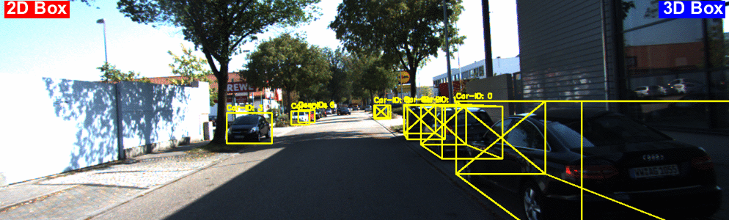
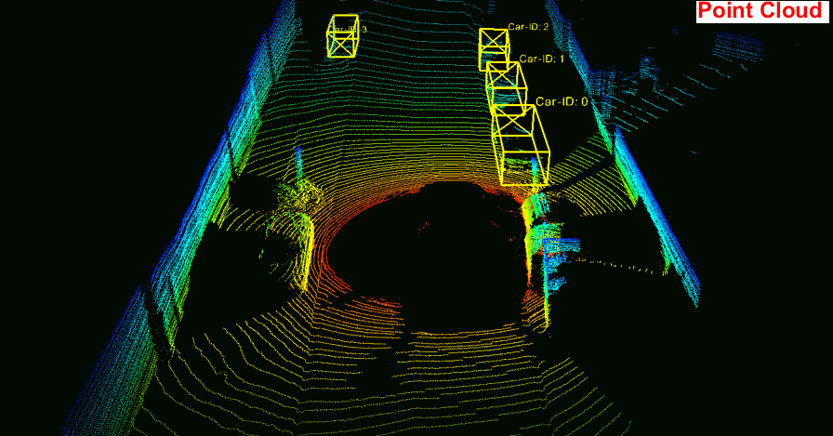
LiDAR Point Cloud Visualization
https://github.com/HengLan/Visualize-KITTI-Objects-in-Videos

Slide 12
Lidar Point Classification
Lidar data points can have multiple classifications.
Flags are used for secondary descriptions.
LAS standard uses classification flags for extra point information.
These flags can be set along with the classification codes.
In LAS version 1.0 : No dual classification of attributes.
In later versions (LAS 1.1 and later), class flags were used.
These flags can be set along with the classification codes.

Slide 13
Classification Flags
The following table describes the classification flags that can be set:
Field name | Description
Synthetic | Non-lidar point, created differently.
Key-point | Key-point exempt from thinning algorithms.
Withheld | The point should not be included in processing.
Overlap | Overlap region point between flight lines.

Slide 14
Classification codes: LAS format 1.1 - 1.4
The following table lists the LAS classification codes defined by ASPRS for these LAS versions:
Classification value | Meaning
0 | Never classified
1 | Unassigned
2 | Ground
3 | Low Vegetation
4 | Medium Vegetation
5 | High Vegetation

Slide 15
Thank you!
Questions?

